Slide 1

Web Application Penetration Testing with OWASP Juice Shop
Eric Noga
12.8.2024
CYB505 Introduction to Cybersecurity

Slide 2
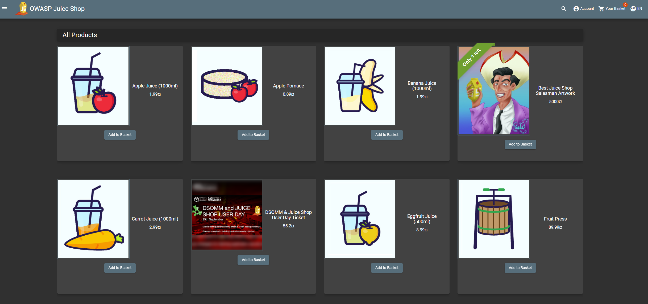
Why This Project?
As an aspiring penetration tester, I wanted to challenge myself with this hands-on project to help simulate a real-world scenario.
I used the OWASP Juice Shop, a vulnerable web application which was to identify and exploit vulnerabilities in a safe and legal environment.
This project helped me refine my skills and understand how to secure applications.

Slide 3
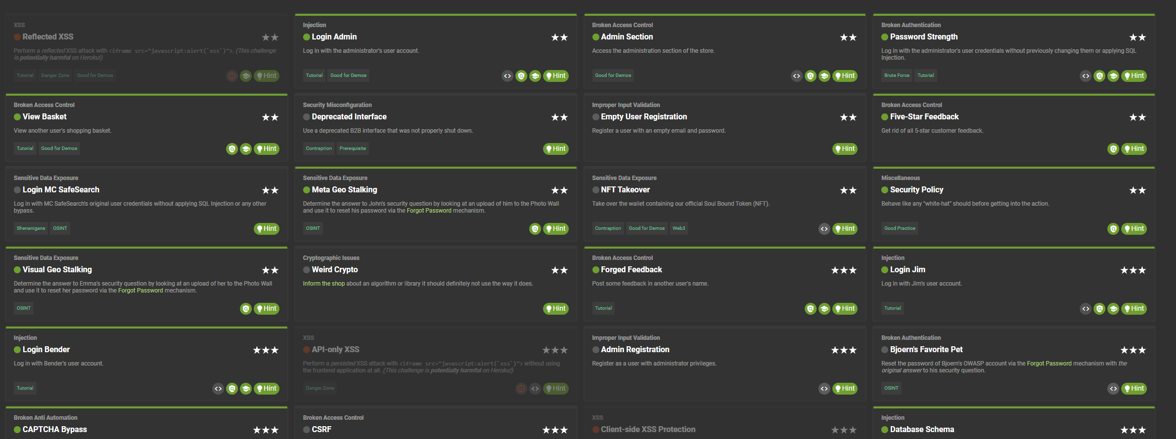
Project Objectives
Gain practical experience in web application penetration testing.
Complete at least two 2-star challenges and two 3-star challenges.
Document findings and recommend mitigations.

Slide 4




Tools and Environment
Tools: Burp Suite, Kali Linux
External Testing Site: juice-shop.herokuapp.com
Local Testing Site: localhost:3000 (offline testing)

Slide 5
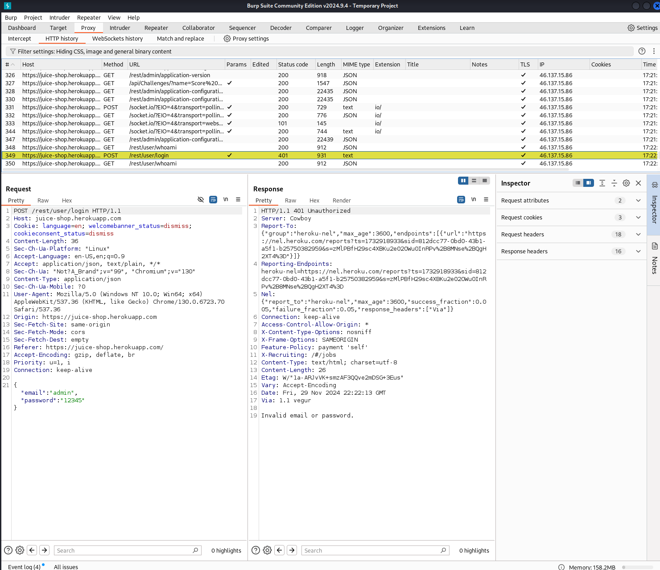
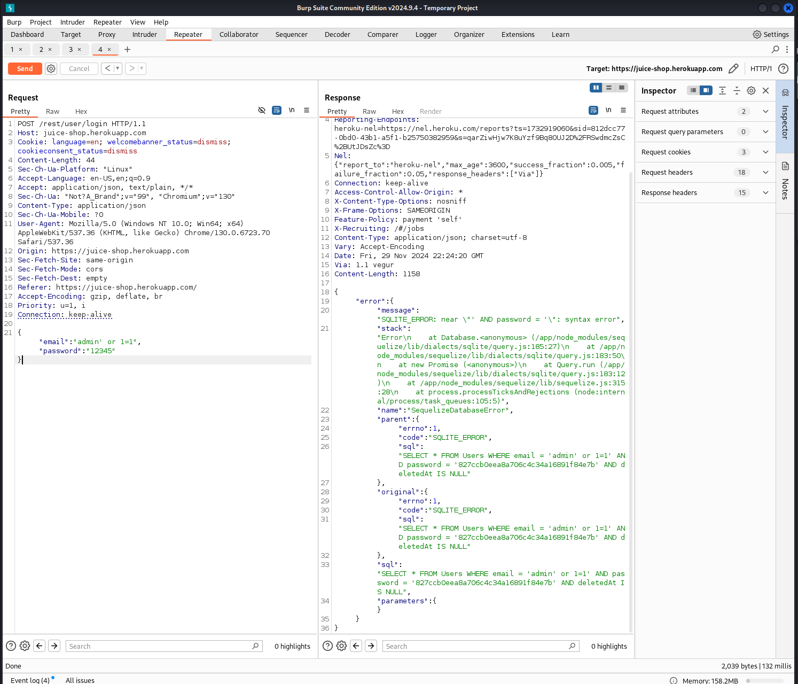
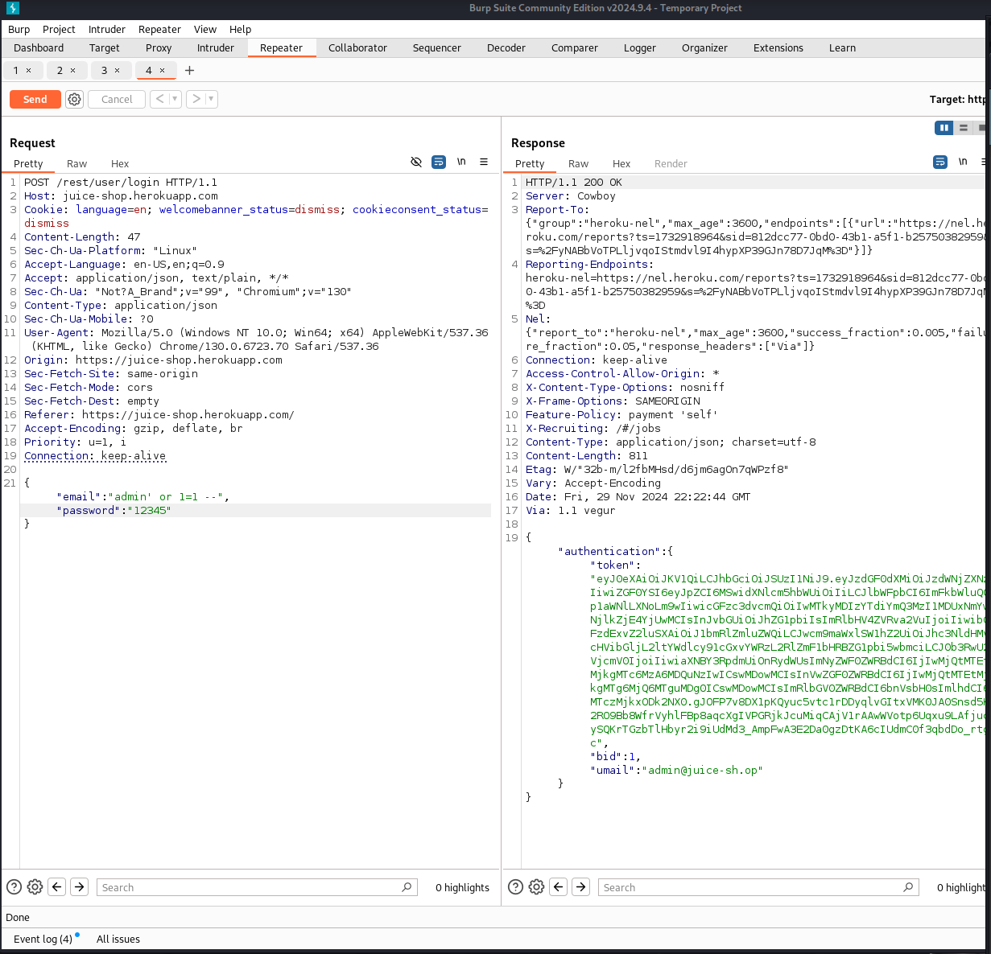
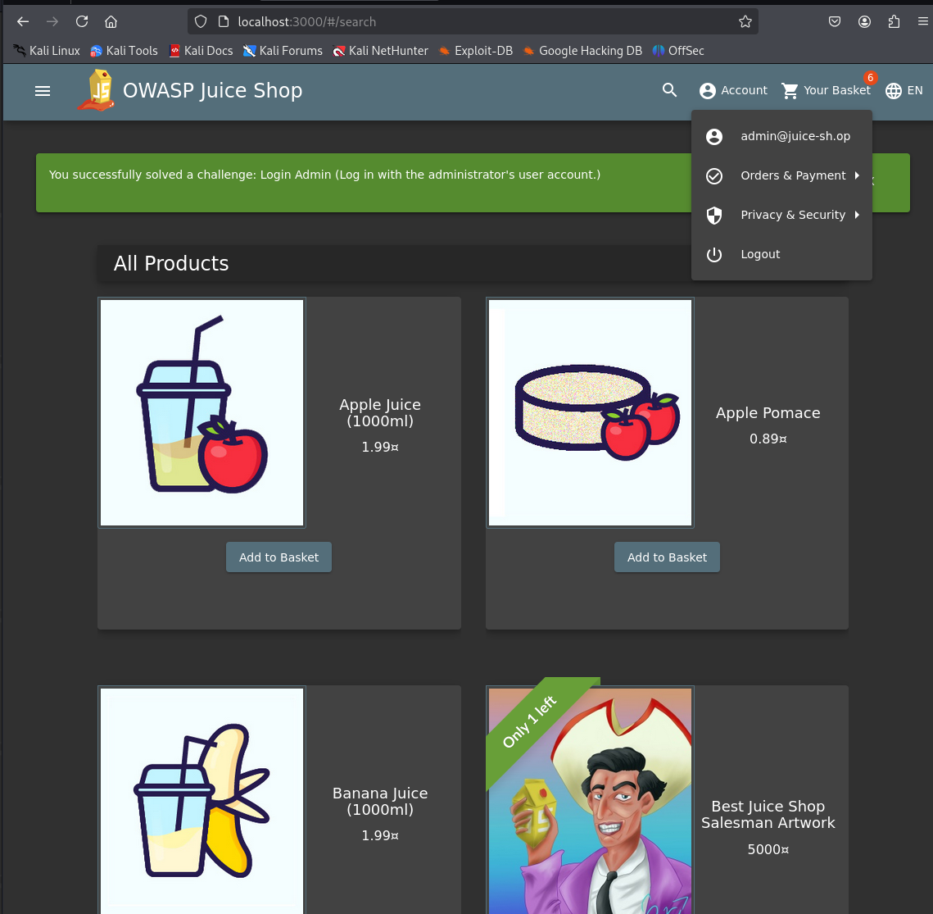
Challenge 1: Login Challenge (2-star)
Objective: Gain unauthorized admin access.
Steps Taken: Used SQL Injection payload (admin’ or 1=1 --) in the username.
Findings: Improper input validation allowed bypassing of authentication.
Mitigations: Utilize prepared statements and sanitize inputs.
Notes:
How I completed this task was I first I went into Burpsuite, Clicked on the photo wall.
Afterwords it displayed a web page inside called logn in my HTTP proxy using Burpsuite.
I typed admin for the username and 12345 for the password inside the login page on Juiceshop.
Then in Burpsuite it provided an error.
I decided to input a random character string of a SQL Injection Payload.
I was able to read the error, then adjusting after a few times, I was able to be authenticated.

Slide 6
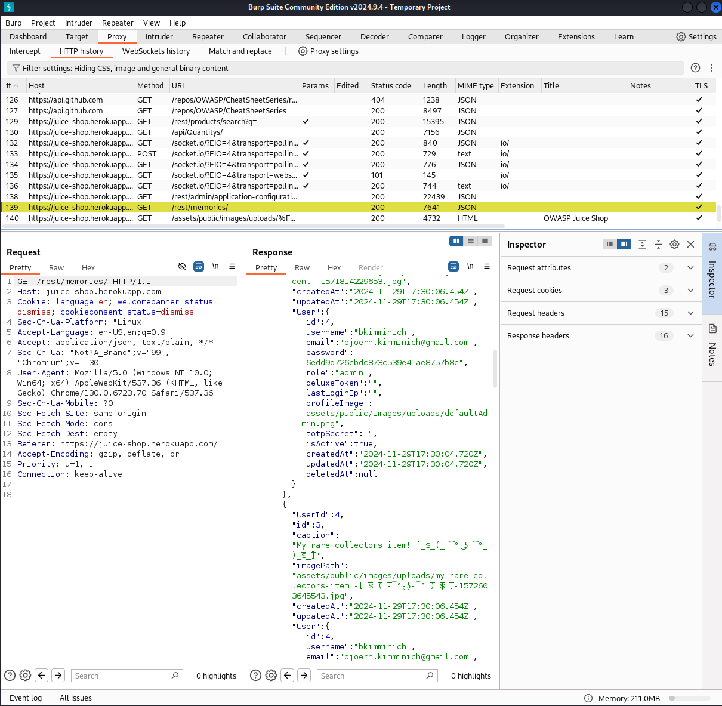
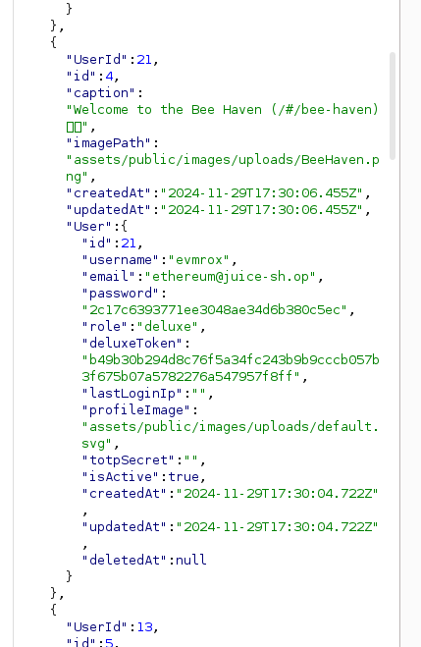
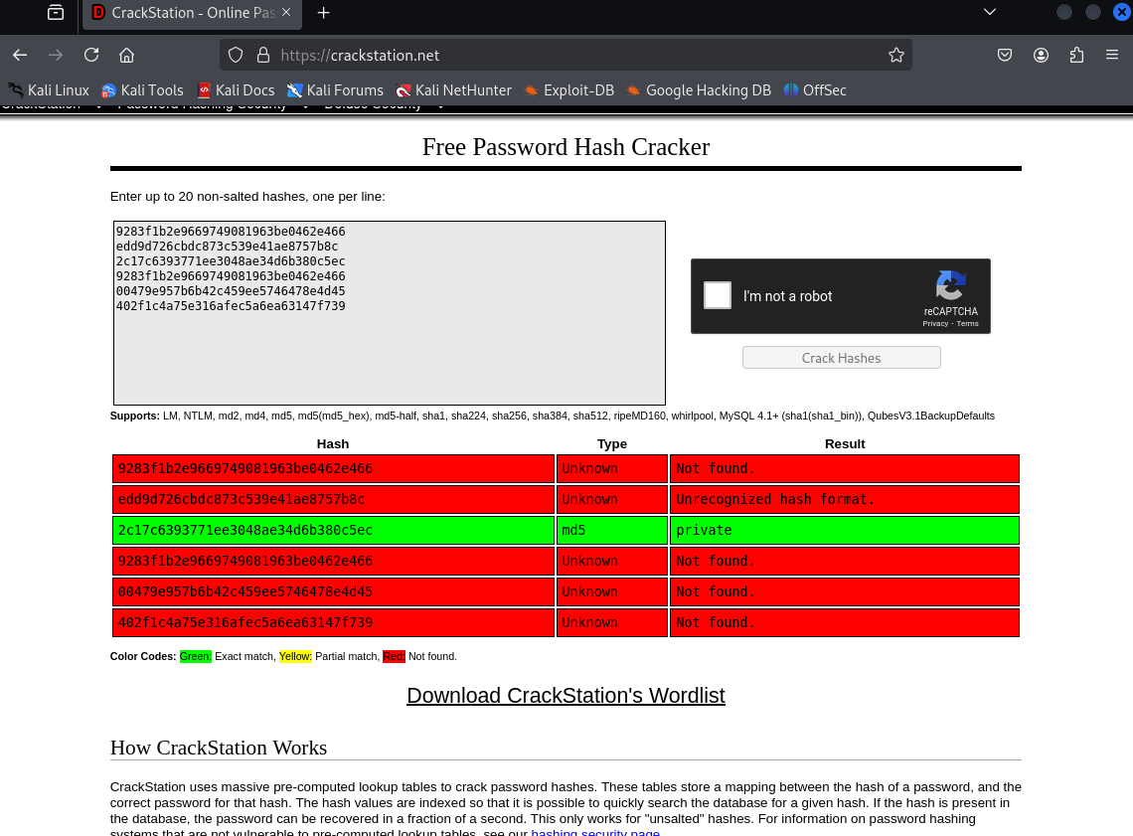
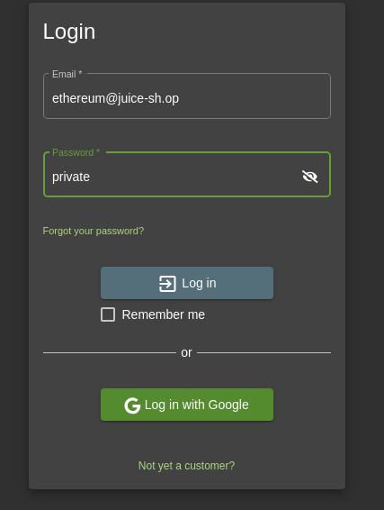
Challenge 2: View Basket Challenge (2-star)Part 1
Objective: Exploit shopping basket functionality.
Steps Taken: Tampered with session cookies in Burp Suite.
Notes:
How I completed this challenge was I went into the photo column and started poking around random URL links.
I came across this memories file and found random username’s and passwords.
I then ran a MD5 checker and found that the username.
After I was able to successfully login.

Slide 7
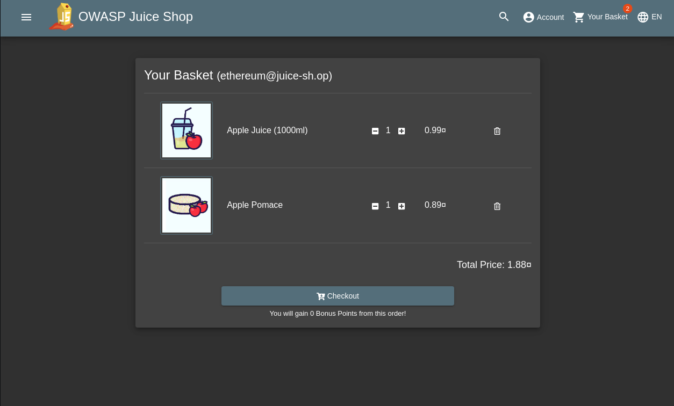
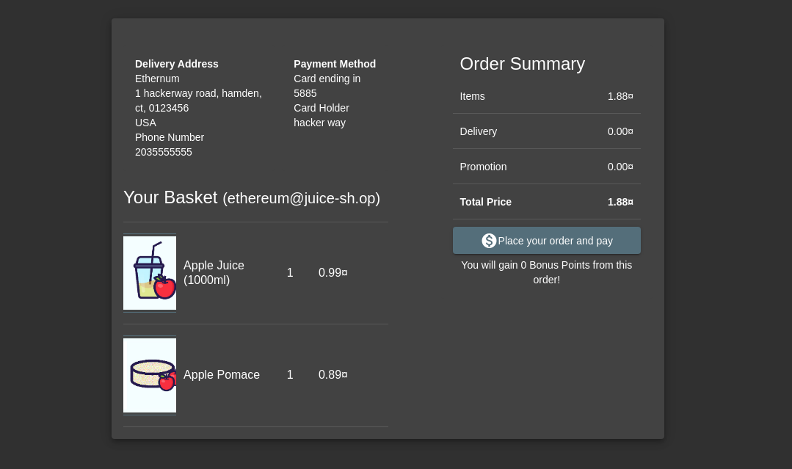
Challenge 2: View Basket Challenge (2-star)Part 2
Findings: Lack of session token validation allowed impersonation.
Mitigations: Use secure cookies and enforce server-side access controls.

Slide 8
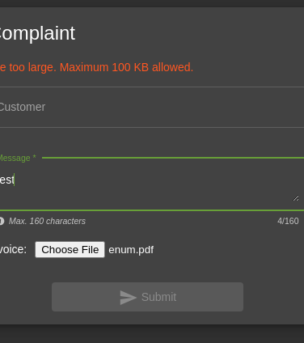
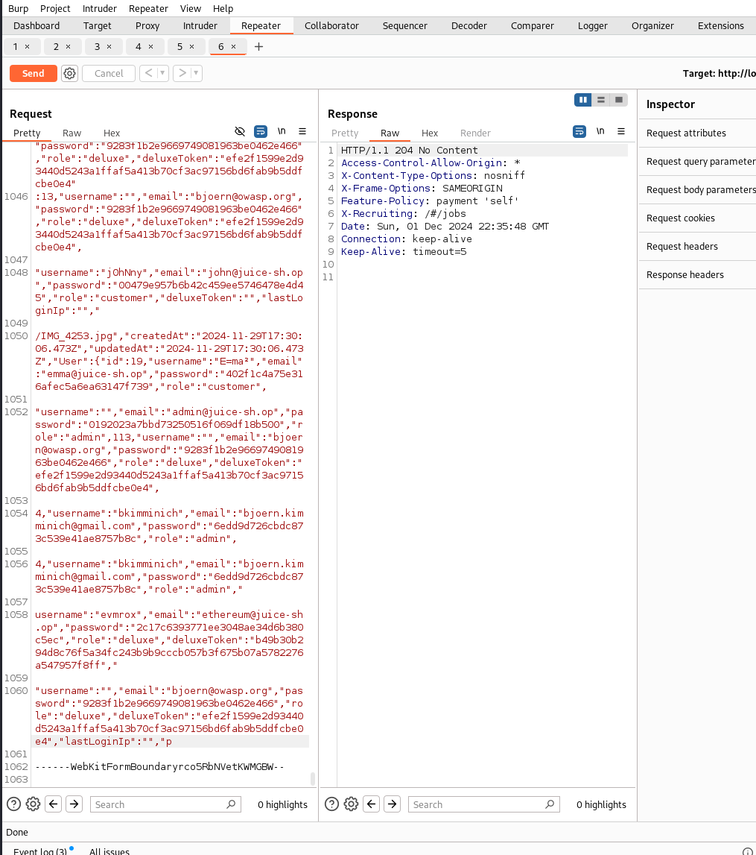
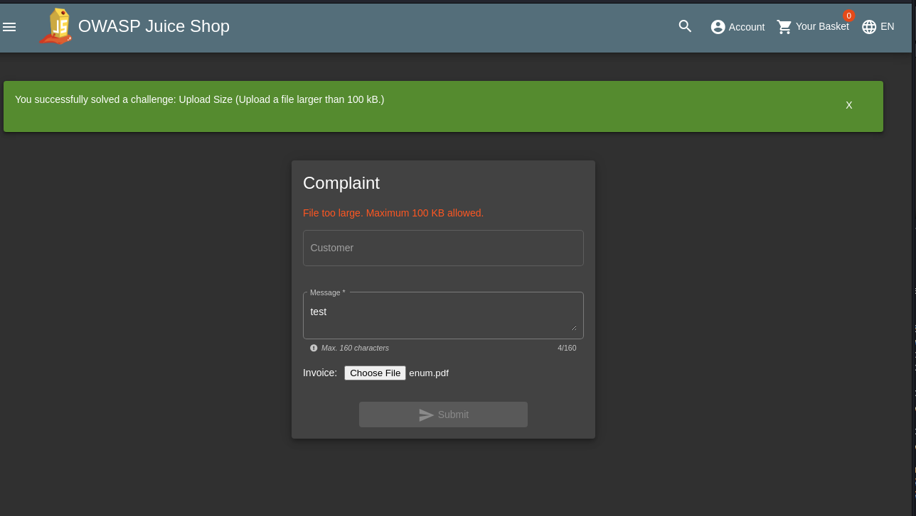
Challenge 3: Upload Size (3-star)
Objective: Exploit file upload functionality.
Steps Taken: Modified the Content-Length header to bypass file size restrictions.
Findings: Server-side validation was missing, enabling DoS attacks.
Mitigations: Enforce file size restrictions server-side and validate uploads.
Notes:
How I completed this challenge was I went to fill out a complaint and tried testing a random PDF.
It said the max was allowed of 100kb.
Then I went into Burpsuite and tired to edit the request in Repeater by spamming random letters and characters.
After modifying the command in Burpsuite
I click send and it ended up working.

Slide 9
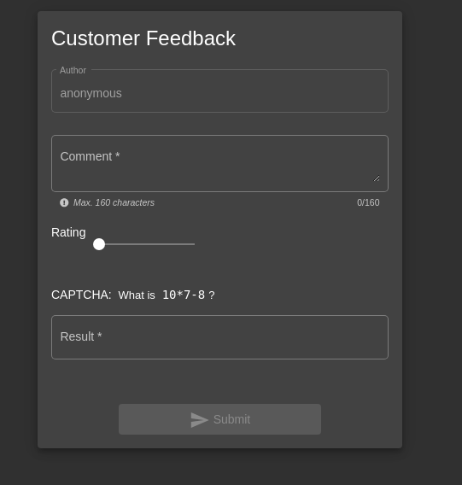
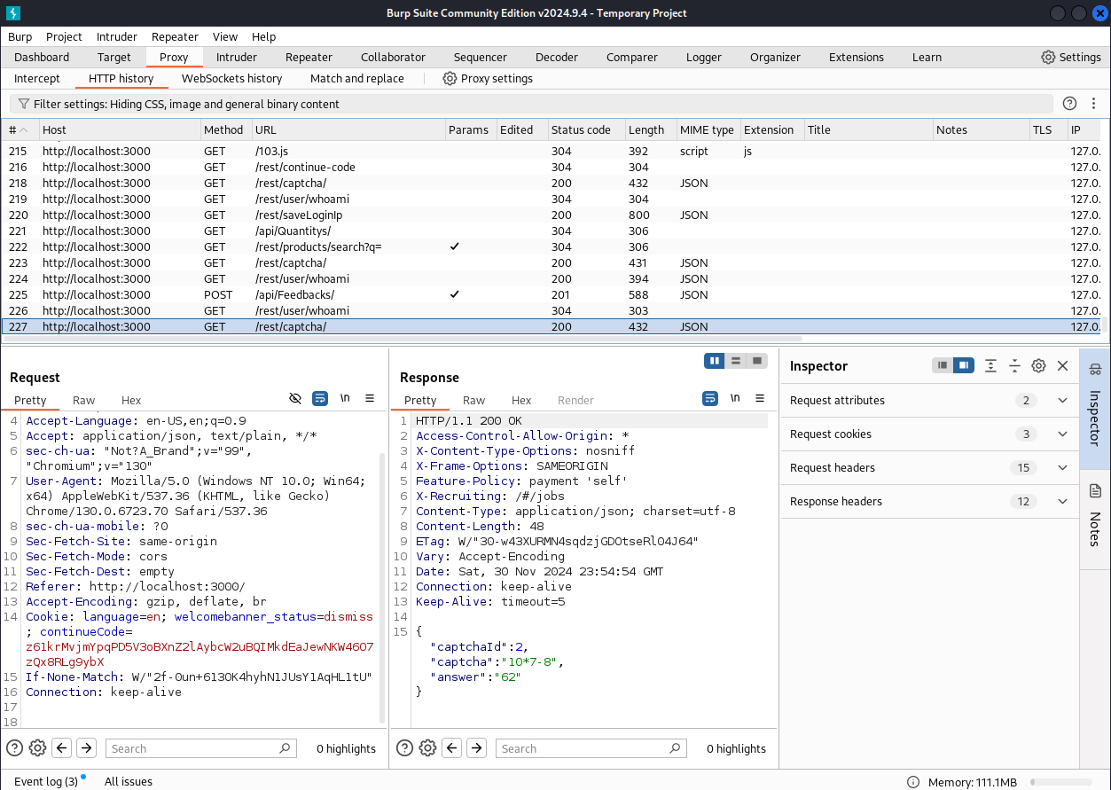
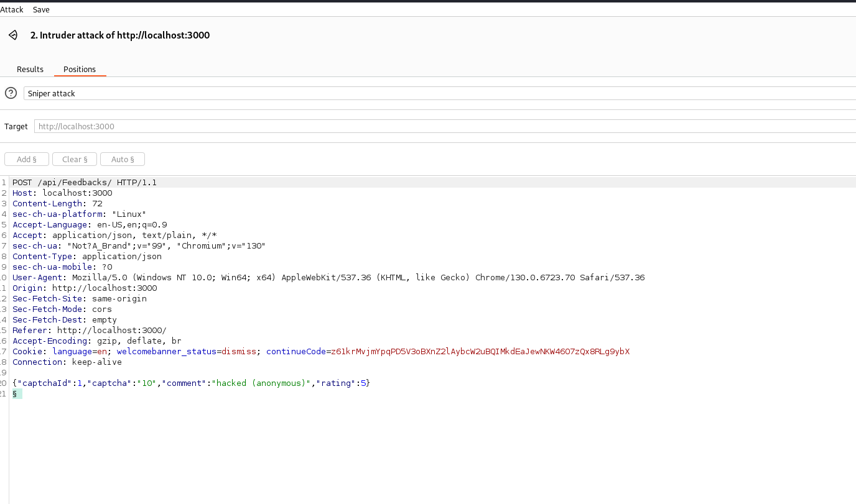
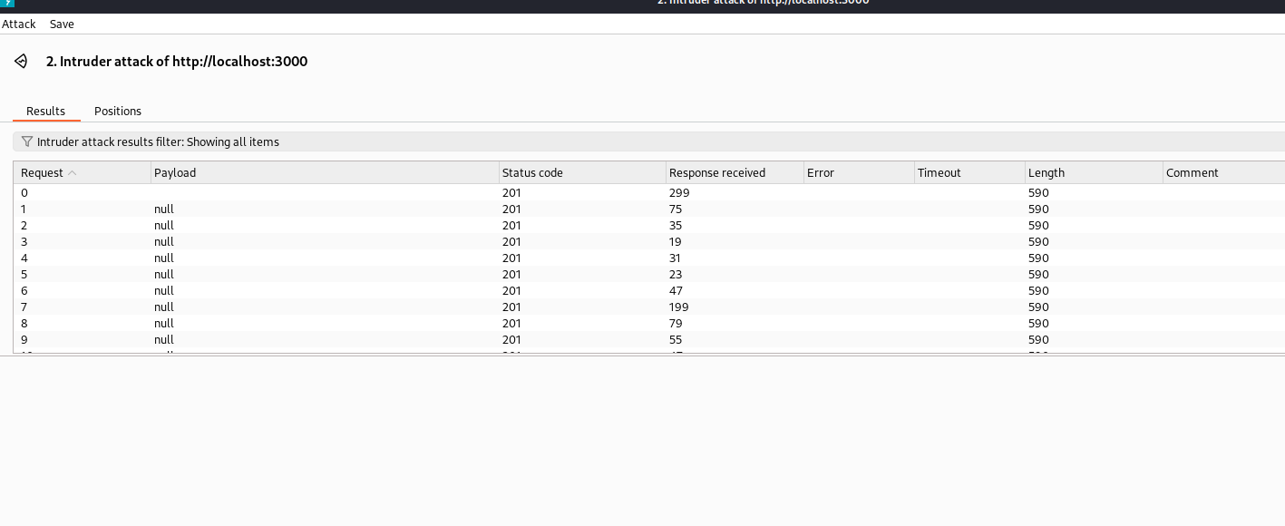
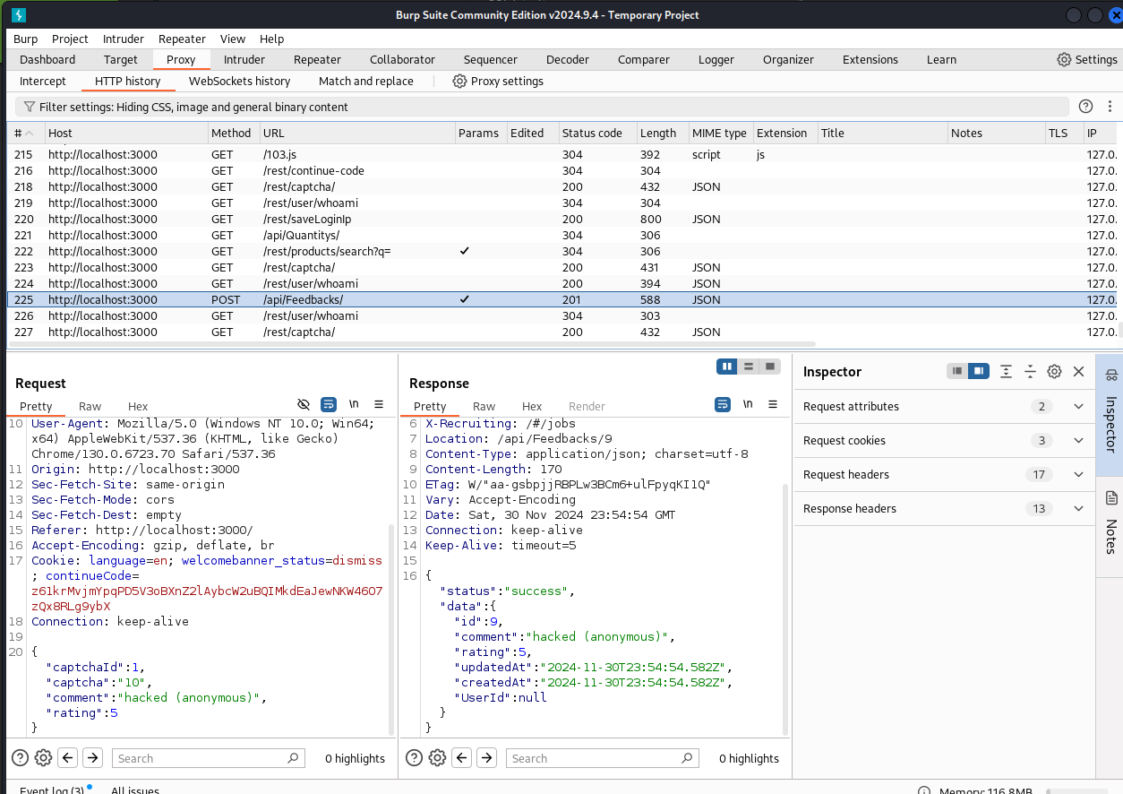
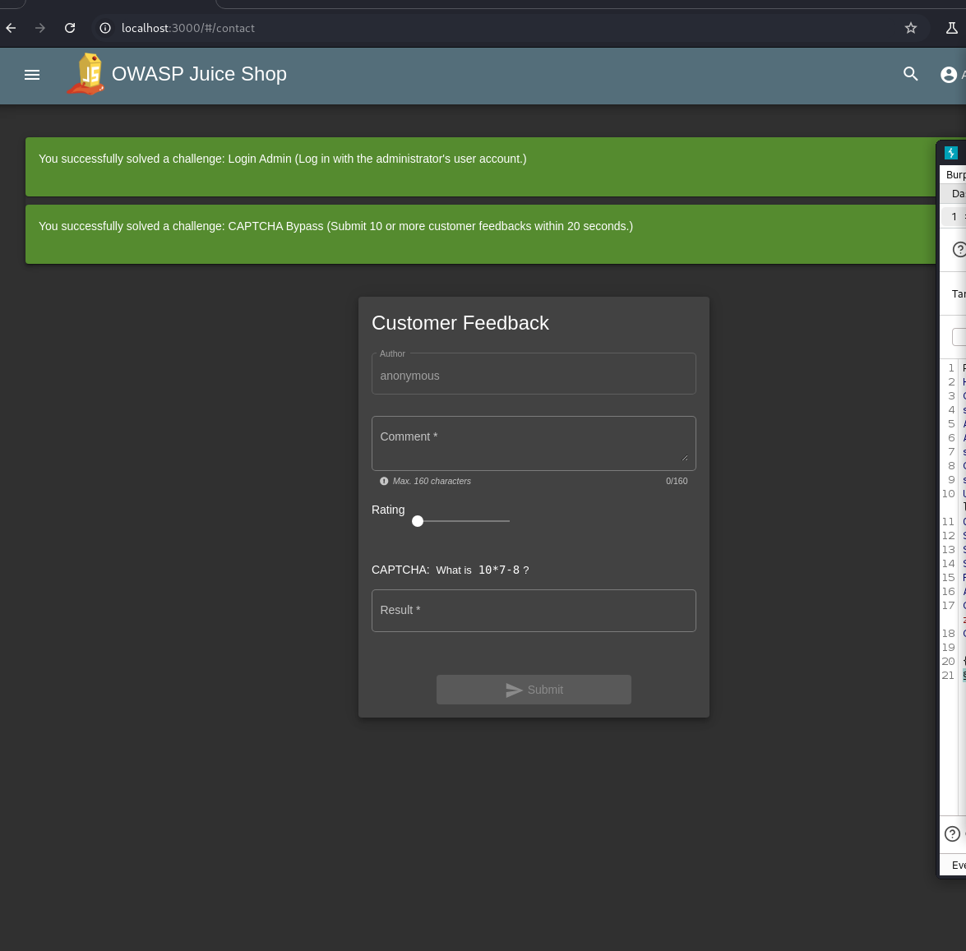
Challenge 4: Captcha Bypass (3-star)
Objective: Bypass CAPTCHA protection.
Steps Taken: Intercepted CAPTCHA requests and submitted the form without solving it.
Findings: Client-side CAPTCHA validation was weak.
Mitigations: Implement server-side CAPTCHA validation and rate-limit requests.
Notes:
How I completed this challenge was I filled out the customer feedback. I then went to the CAPTCHA in burpsuite. I then dedided to run an intruder payload of null strings. After spamming it around 20 times, I was successful on bypassing the captcha.

Slide 10
Q/A

